Slide 1
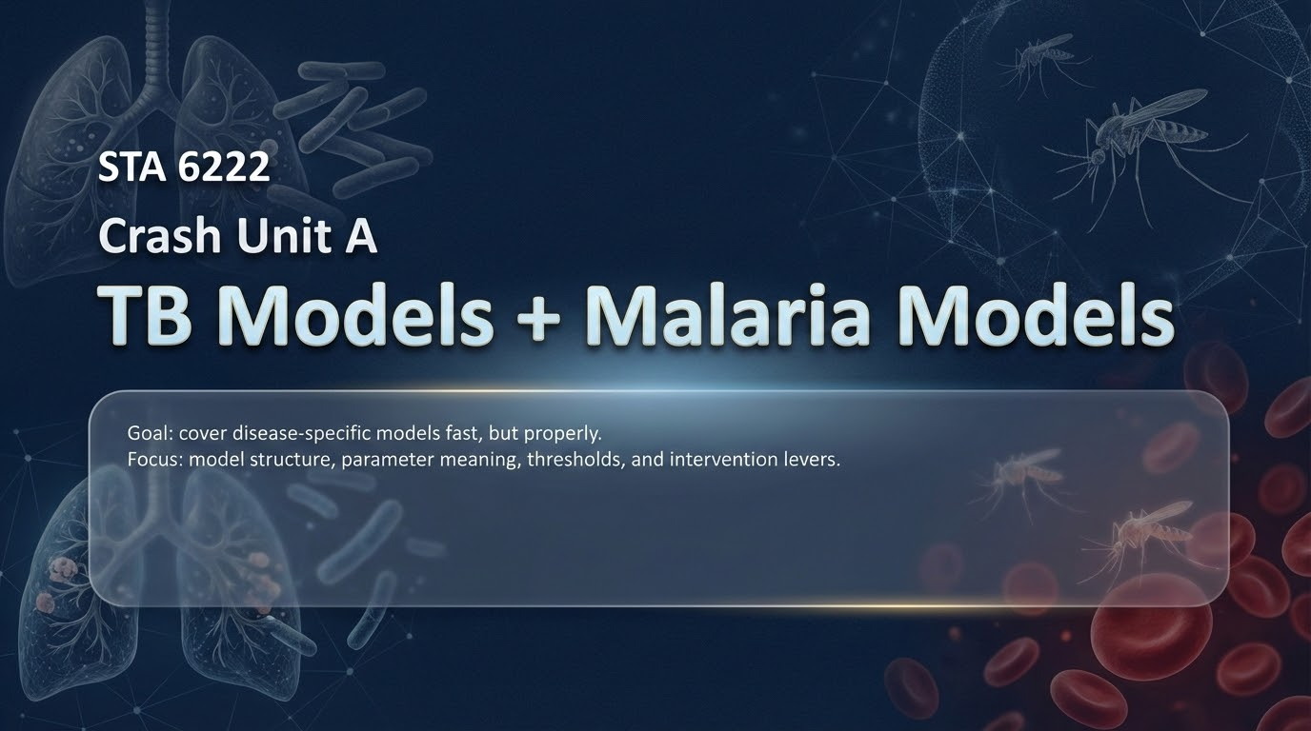
Notes:
Today’s session is a focused crash unit on two disease-specific modelling blocks: TB models and malaria models. The point is not to drown in detail, but to cover the pieces that actually matter in modelling and in the exam: model structure, parameter meanings, threshold ideas like R₀, and how interventions appear as parameter changes. TB and malaria are ideal for this because they force us to respect biology. TB forces us to include latency, because infection does not immediately mean infectiousness. Malaria forces us to include vectors, because transmission is not direct human-to-human. As we go, keep one habit: whenever you see a compartment or a parameter, ask what biological process it represents and what a public health program could realistically change about it.

Slide 2
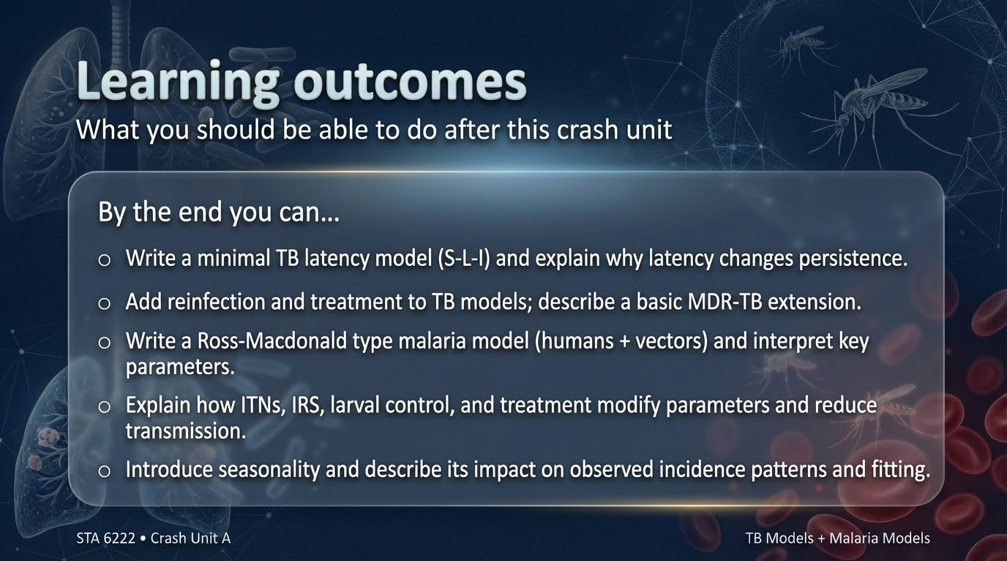
Notes:
At the end of this crash unit, these key abilities are very specific.
First, it should be natural to write a minimal TB model with S, L, I and to explain clearly why latency changes the whole story of persistence and timing.
Second, it should be clear how reinfection and treatment enter TB models: reinfection as partial immunity or reduced susceptibility, and treatment as a mechanism that shortens infectious duration and changes outcomes.
Third, for malaria, it should be natural to write a minimal host–vector model, define the forces of infection for humans and vectors, and explain what controls R₀ in malaria systems.
Finally, seasonality must make sense conceptually: a time-varying biting rate or vector density produces waves, shifts peaks, and makes model fitting harder.
If you can do these things, you can handle the exam-style questions on TB and malaria models confidently.

Slide 3
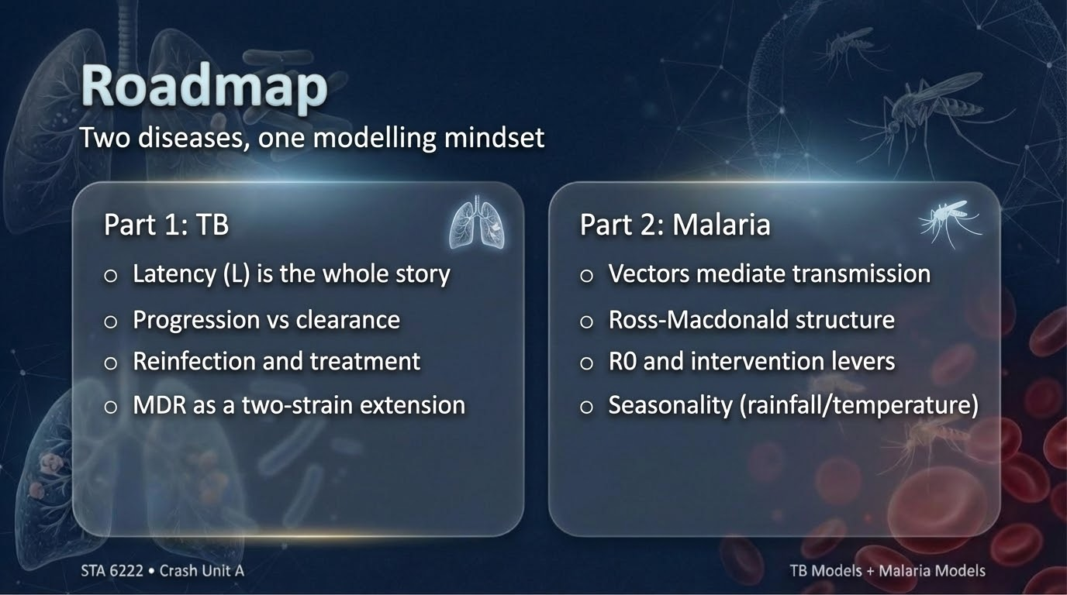
Notes:
This crash unit has two parts. Part 1 is TB. The central message is that latency is not a small modification; it changes the time-scale and persistence of the disease. We’ll express TB as flows through S to L to I, then interpret progression versus clearance, and then add reinfection, treatment, and drug resistance in a structured way.
Part 2 is malaria. The central message is that vectors mediate transmission, so the model must include mosquitoes explicitly. We’ll build a Ross–Macdonald style host–vector loop, interpret R₀ in terms of biting and survival, show how ITNs and IRS change parameters, and finally introduce seasonality using a time-varying parameter such as the biting rate.

Slide 4
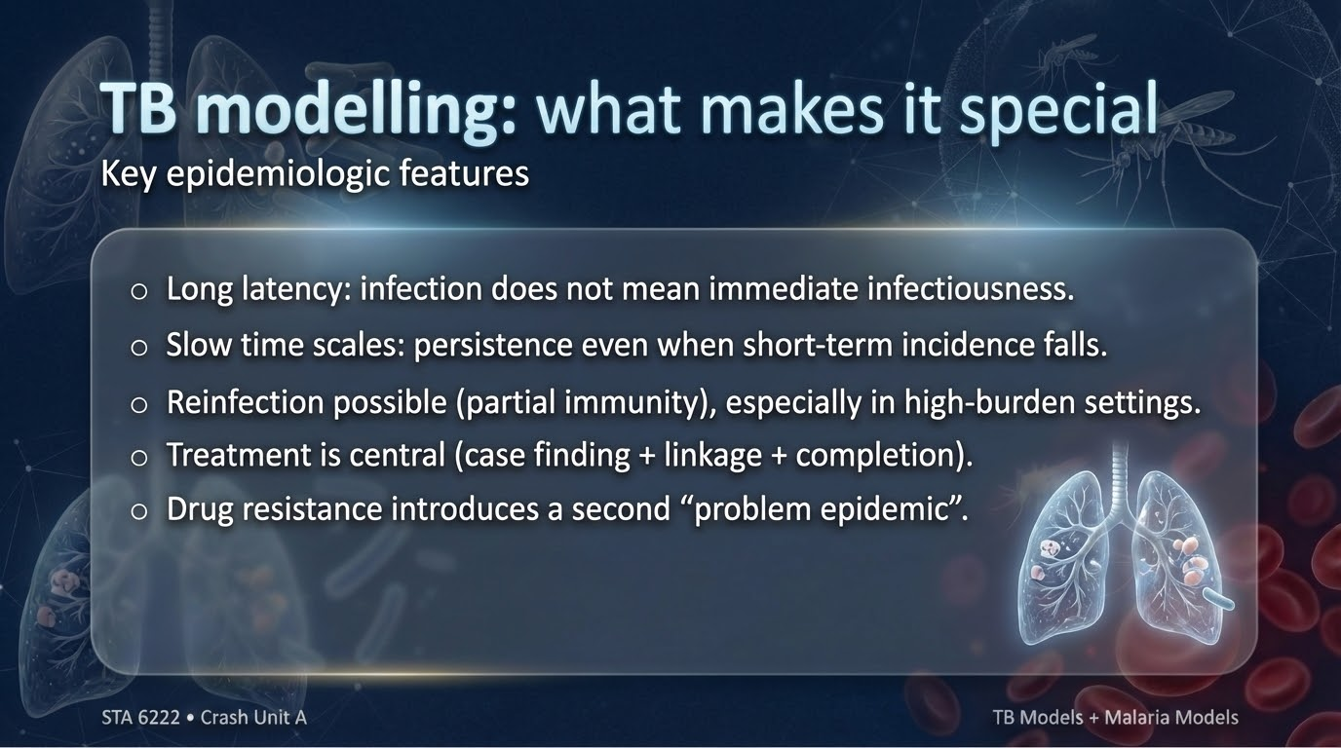
Notes:
Slide 4 — TB modelling: what makes it special
TB is a classic example where biology forces the mathematics.
The key features are:
long latency, meaning many infected people stay in a latent state for years;
slow dynamics, meaning incidence can lag behind transmission changes;
possible reinfection, especially where exposure is frequent; and
treatment-driven control, meaning programmatic performance—case finding, linkage, adherence—directly changes the model.
TB also has the extra complexity of drug resistance, which effectively creates a second epidemic embedded inside the first. So TB modelling is always about two pools: the latent pool, which stores risk for the future, and the infectious pool, which drives transmission now. If a model ignores latency, it misses TB’s most important behaviour: delayed cases and persistent burden even when transmission falls.

Slide 5
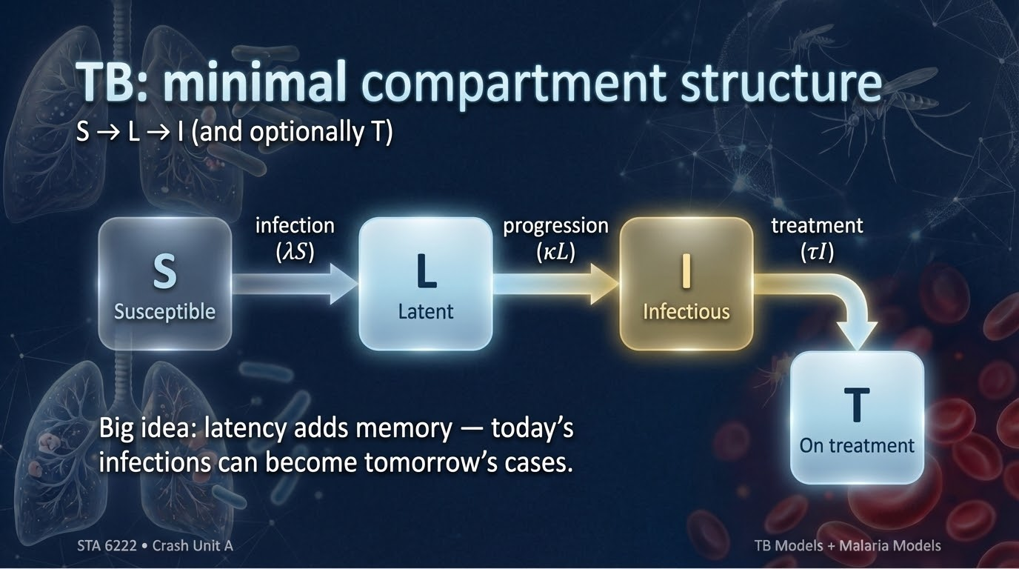
Notes:
Slide 5 — TB: minimal compartment structure
A minimal TB model uses three compartments: S for susceptible, L for latent infection, and I for infectious TB.
The key pathway is S → L → I. That structure is already telling you something profound: infection does not instantly create infectiousness. People can enter L and stay there for long periods, and then later progress to I through reactivation or progression. This is why TB is persistent: the latent compartment acts like a reservoir of future infectious cases. In practice, you may also include a treatment compartment T, but the minimal message is already captured by S–L–I. In this model, the exam-level questions typically ask you to write the flows, define parameters, and explain why latency changes timing and persistence compared to a simple SIR disease.

Slide 6
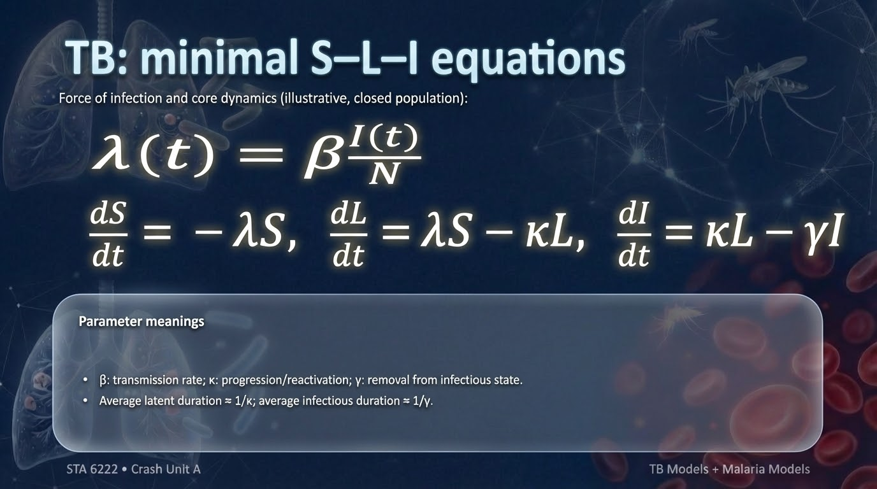
Notes:
Slide 6 — TB: minimal S–L–I equations
The minimal TB equations start by defining a force of infection. In a closed population, one common form is: 𝝀(t) = 𝞫 I(t) / N
Then the dynamics can be written as: dS/dt = – 𝝀S dL/dt = 𝝀S – 𝜿L dI/dt = 𝜿L – 𝞬I
Here, beta(𝞫) is the transmission parameter; kappa(𝜿) is the progression or reactivation rate from latent to infectious TB; and gamma(𝞬) is the rate of leaving the infectious state. Two time-scale interpretations are very useful: average time in latency is approximately 1/𝜿 (kappa), and average time infectious is approximately 1/𝞬 (gamma). The important conceptual point is that new infections first accumulate in L, not in I, so incidence of infectious TB depends heavily on kappa and the size of the latent pool.

Slide 7
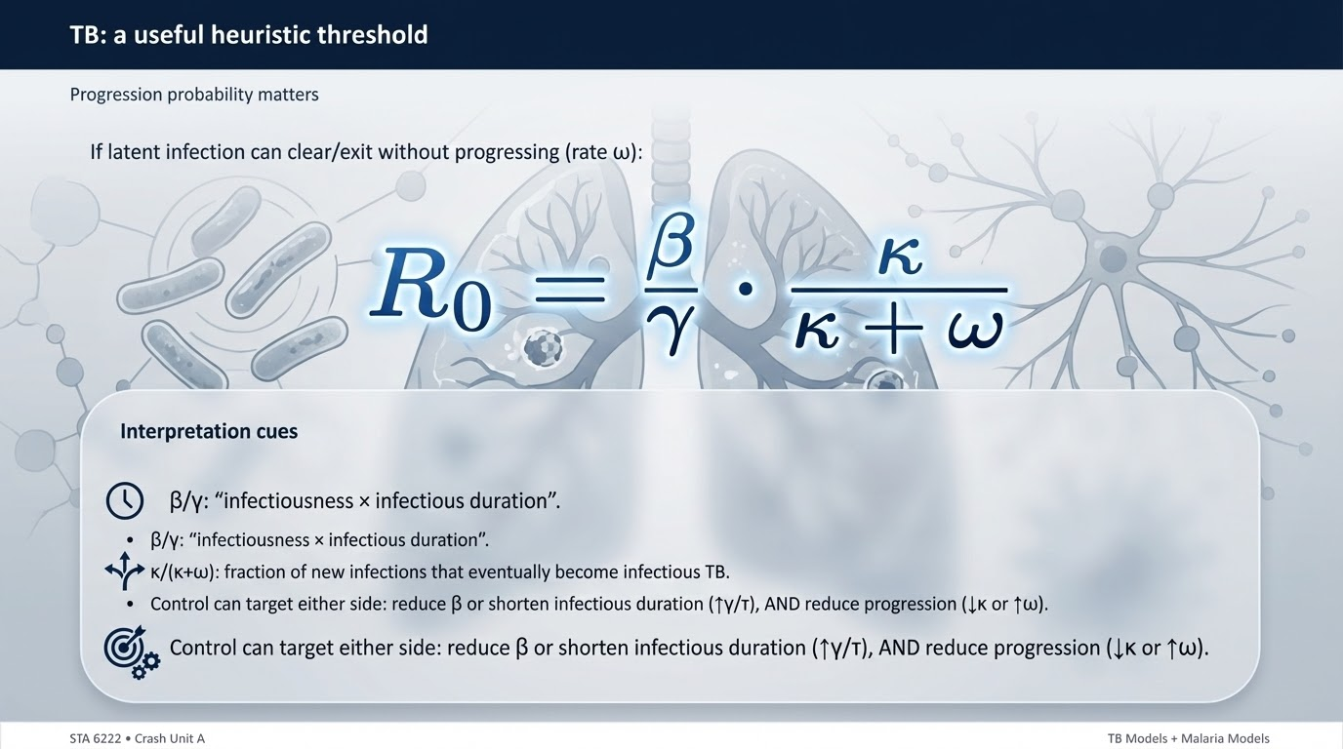
Notes:
Slide 7 — TB: a useful heuristic threshold
A useful way to think about TB thresholds is to recognize that not everyone who becomes infected will eventually become infectious. If latent infection can also “clear” without progression at some rate omega, then the probability of progression is: prob(progress) = 𝜿 / (𝜿 + 𝟂)
A clean heuristic form for R0 is then: R₀ = (𝞫 / 𝞬) * (𝜿 / (𝜿 + 𝟂))
This reads naturally: 𝞫 / 𝞬 is the familiar “transmission potential per infectious person,” and the progression fraction adjusts for the fact that TB spends time in latency and may never progress. This makes the control message very clear: TB control is not only about lowering beta(𝞫). It can also work by reducing progression (lower kappa(𝜿) or higher omega(𝟂)) and by shortening infectious duration (higher effective gamma(𝞬) through rapid diagnosis and treatment).

Slide 8
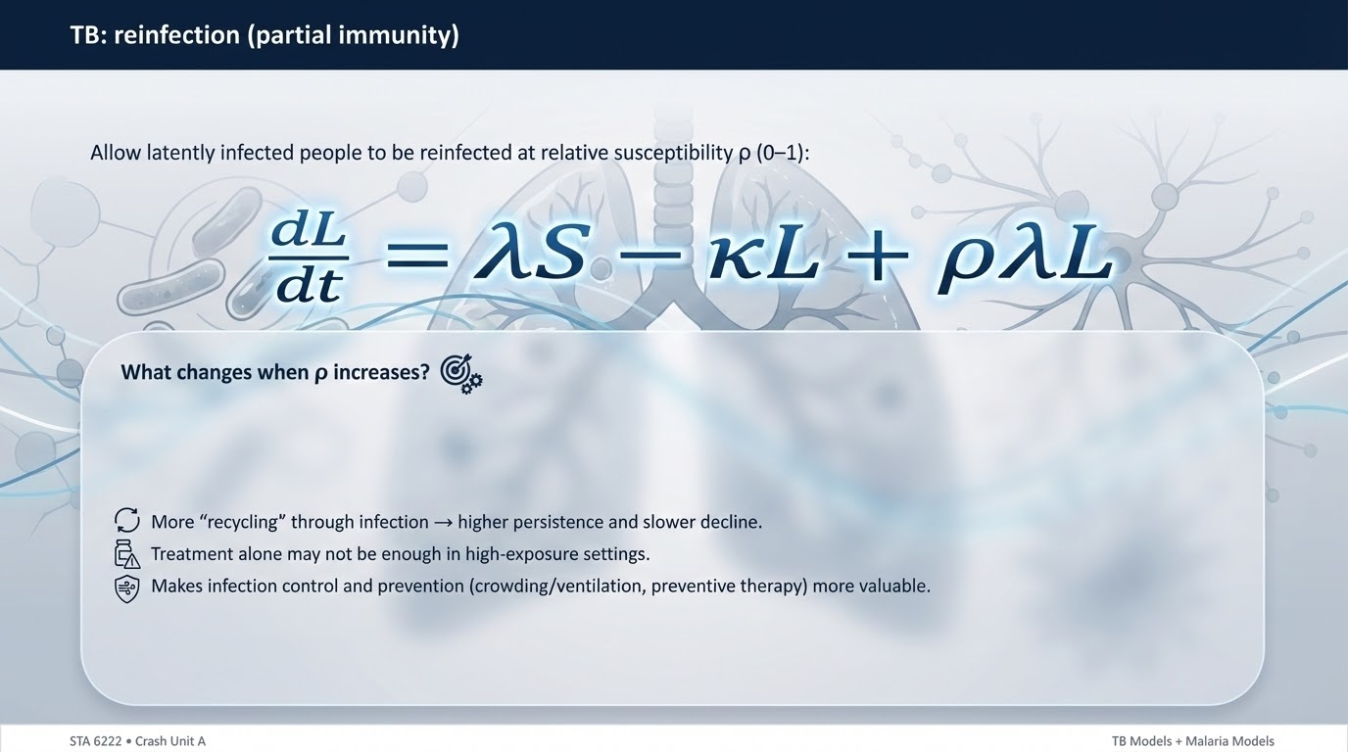
Notes:
Slide 8 — TB: reinfection (partial immunity)
In TB, people who are latently infected may still be reinfected, but often at a reduced susceptibility compared to fully susceptible individuals. A simple way to represent that is to let latent individuals experience infection pressure scaled by rho(𝝆), where 0 ≤ rho(𝝆) ≤ 1. If rho = 0, latent individuals are fully protected from reinfection; if rho is near 1, they are almost as susceptible as susceptibles. Conceptually, reinfection matters because it increases persistence: transmission can continue to “feed” the latent pool even when susceptible numbers shrink. One simple modelling modification is to include reinfection into the latent equation: dL/dt = lambdaS - kappaL + rholambdaL The exam-level reasoning is to explain what rho means and what happens as rho increases: more sustained transmission, more difficulty achieving control, and more value from interventions that reduce exposure.

Slide 9
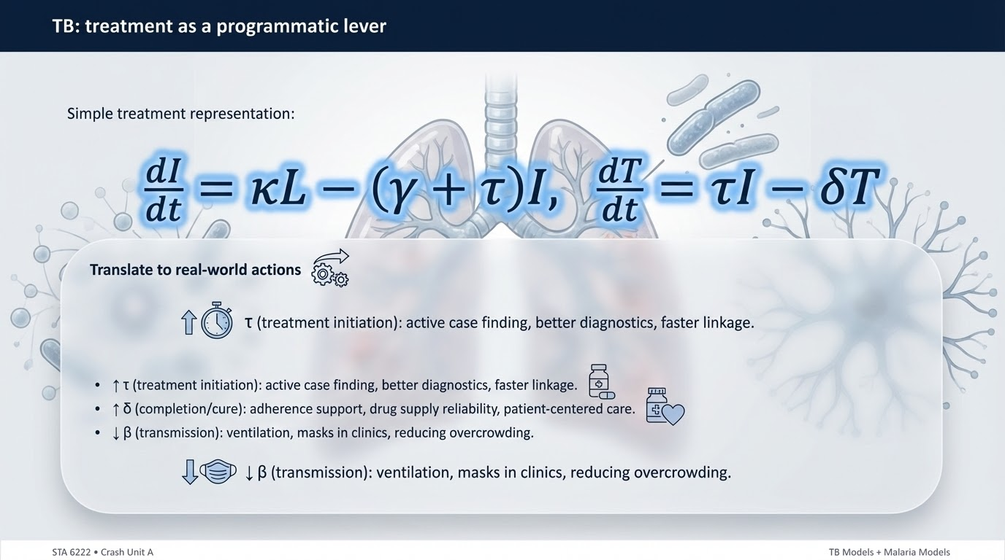
Notes:
Slide 9 — TB: treatment as a programmatic lever
Treatment enters TB models as a way to shorten infectious duration and reduce onward transmission. A simple extension adds a treatment compartment T and a treatment initiation rate tau. One illustrative structure is: dI/dt = 𝜿L – (𝞬 + 𝝉)I dT/dt = 𝝉I – 𝜹T
Here, tau(𝝉) is the rate at which infectious individuals start effective treatment—this captures case finding, diagnosis, and linkage. delta(𝜹) is the rate of completing treatment successfully. The key interpretation is that raising tau(𝝉) reduces the average time a person spends infectious in the community, which lowers transmission. Raising delta(𝜹) improves throughput and reduces prolonged infectiousness due to failure or default. In real program terms, tau(𝝉) improves with better screening and faster diagnostics, and delta(𝜹) improves with adherence support and reliable drug supply.

Slide 10
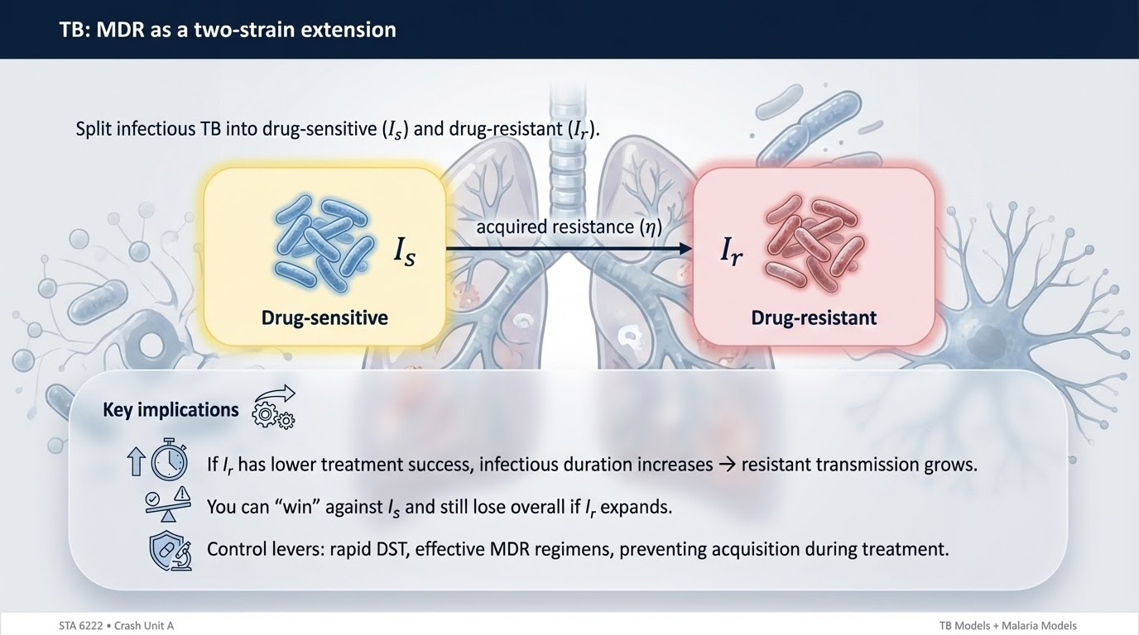
Notes:
Slide 10 — TB: MDR as a two-strain extension
Drug resistance is naturally represented by splitting the infectious class into two compartments: drug-sensitive infectious TB (I_{s}) and drug-resistant infectious TB (I_{r}). The resistant class may have different treatment success, different duration of infectiousness, and different transmission consequences. A key additional mechanism is “acquired resistance” during inadequate treatment, which can be represented as flow from I_{s} to I_{r} at a rate eta(𝜼): I_{s} →I_{r} at rate eta(𝜼)
The interpretation is straightforward: even if drug-sensitive TB is controlled, resistant TB can expand if acquisition during treatment is common or if resistant TB has longer infectious duration due to poorer treatment outcomes. Programmatically, this highlights why good treatment is not just “patient benefit”; it is also resistance prevention. Exam questions usually focus on how you would structure the model and what program implication follows from the structure.

Slide 11
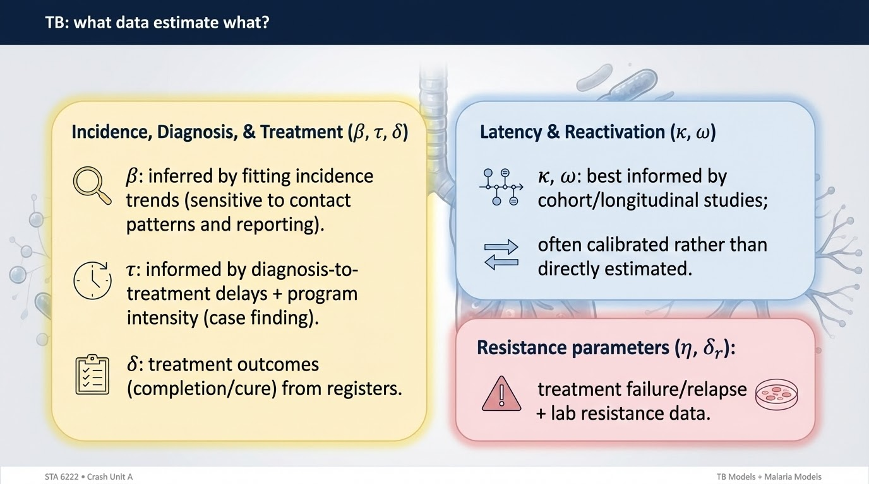
Notes:
Slide 11 — TB: what data estimate what?
Different TB parameters are informed by different kinds of data. Transmission parameters like beta are often indirectly inferred by fitting incidence or prevalence trends, but they are sensitive to reporting and mixing assumptions. Treatment parameters can be more directly informed: tau relates to diagnosis-to-treatment delay and case-finding intensity; delta relates to treatment completion and cure rates in program registers. Progression parameters like kappa and clearance parameters like omega are much harder to estimate from routine surveillance alone and often come from cohort studies or are calibrated. For MDR extensions, acquisition or resistance-related parameters are informed by treatment failure, relapse, and lab-confirmed resistance patterns. The point is: good modelling uses measured program data where possible and reserves curve-fitting for what cannot be measured directly.

Slide 12
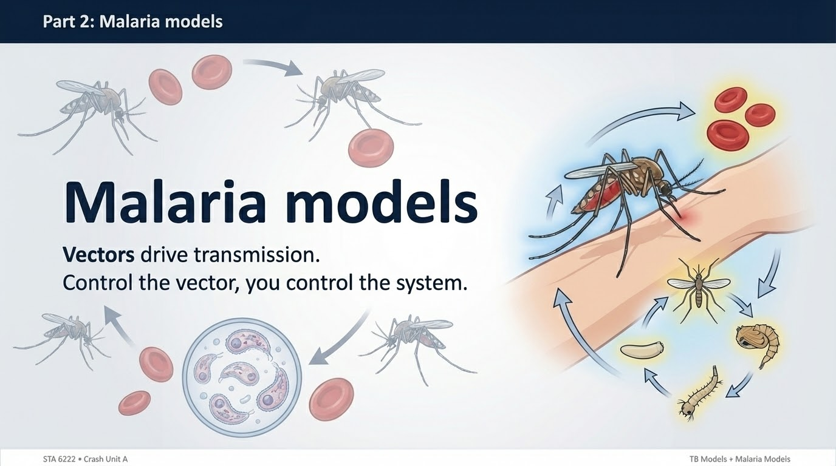
Notes:
Slide 12 — Part 2
Now the session switches from TB to malaria. The modelling mindset stays the same: we identify the biology that forces the model structure, define the key parameters, then interpret R₀ and intervention levers. What changes is the mechanism of transmission. For malaria, transmission is not direct human-to-human. It is mediated by mosquitoes, so we must represent humans and vectors explicitly.

Slide 13
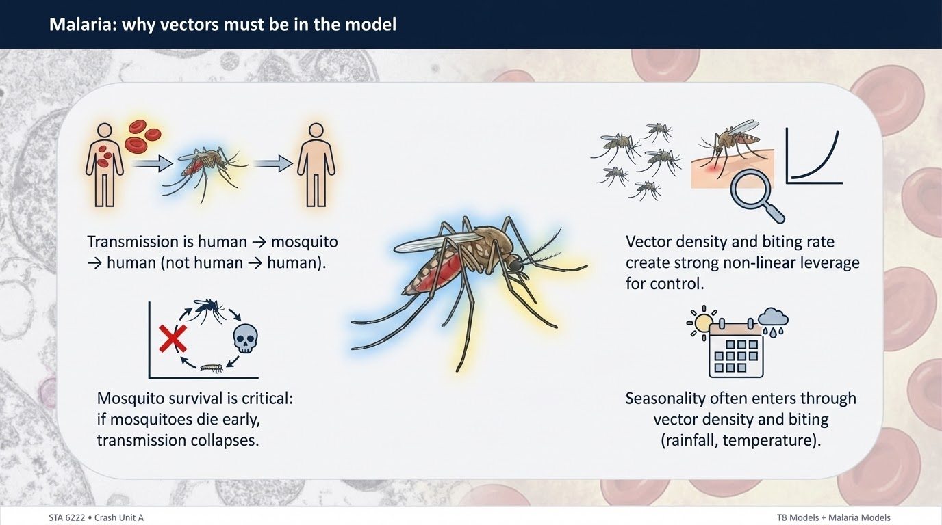
Notes:
Slide 13 — Malaria: why vectors must be in the model
Malaria cannot be modelled properly as a simple SIR in humans alone, because transmission occurs through the vector. The infectious human does not infect another human directly; the infectious human infects a mosquito, and that mosquito later infects a human. This creates two linked infection processes and introduces new parameters that are not optional: biting rate, mosquito density, mosquito death rate, and mosquito incubation.
The model must reflect the ecological reality that mosquito survival is a major determinant of transmission potential. This is also why malaria often shows strong seasonality: vector density and biting behaviour respond to rainfall and temperature. So malaria modelling is not just infection dynamics—it is infection dynamics interacting with vector ecology.

Slide 14
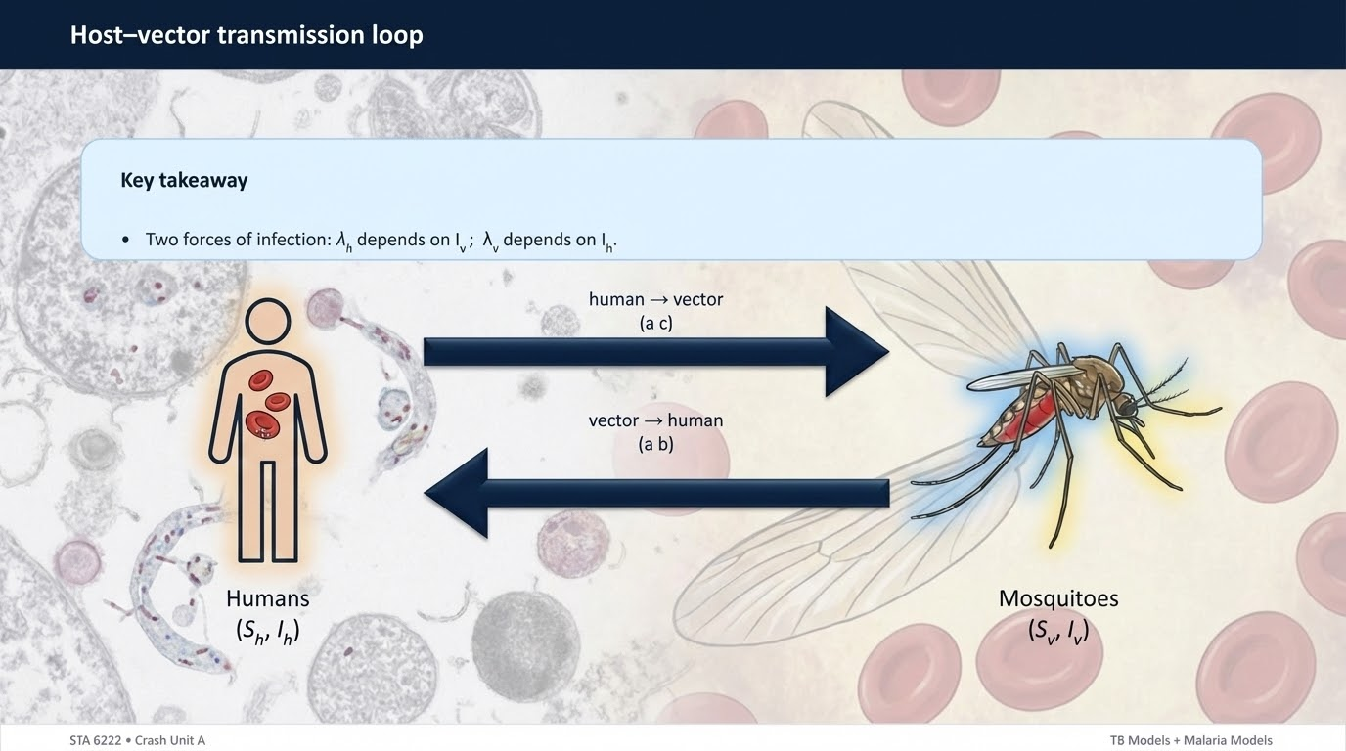
Notes:
Slide 14 — Host–vector transmission loop
A minimal malaria model uses humans and mosquitoes. For humans we often use compartments like S_{h} and I_{h}, and for vectors we use S_{v} and I_{v}. The critical feature is the two-way loop: infectious mosquitoes produce new human infections, and infectious humans produce new mosquito infections. This loop is expressed through two forces of infection: one for humans driven by the fraction of infectious mosquitoes, and one for mosquitoes driven by the fraction of infectious humans. Once that is clear, the structure of the differential equations becomes intuitive: each infectious compartment increases from its own force of infection multiplied by susceptibles, and decreases by recovery or death. The key insight is that interrupting either side of the loop can disrupt transmission.

Slide 15
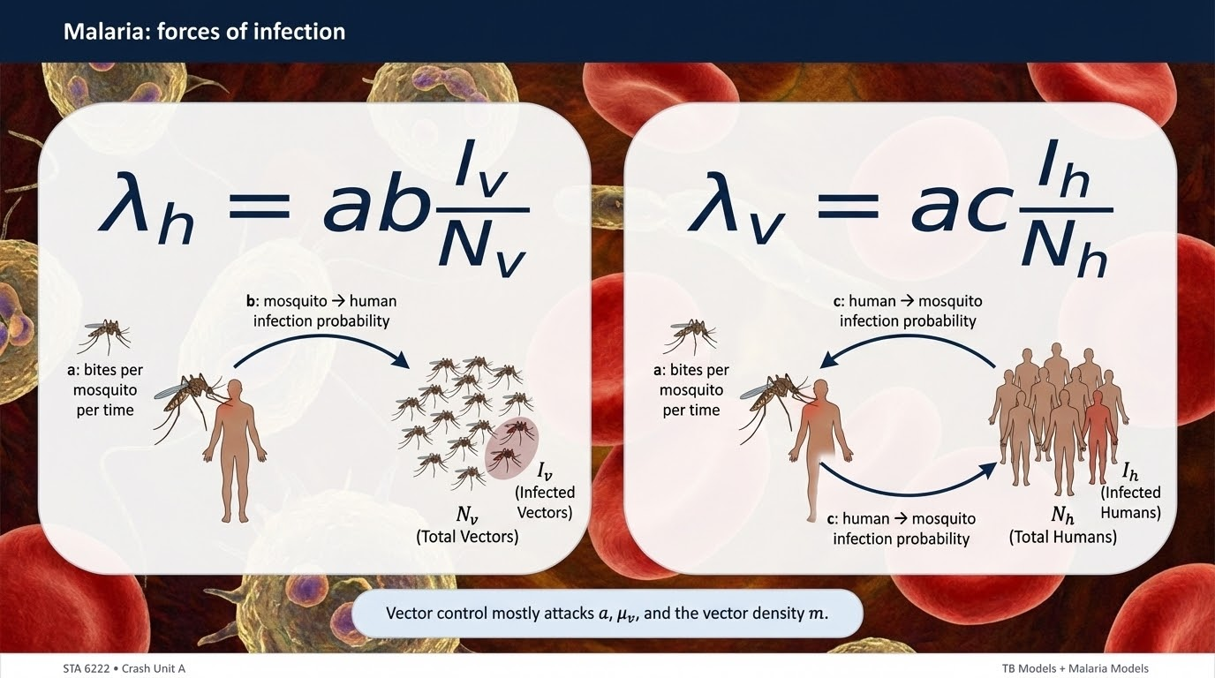
Notes:
Slide 15 — Malaria: forces of infection
In malaria, the forces of infection are typically written as: lambda_h = a * b * (I_v / N_v) 𝝀_{h} = ab(I_{v}/N_{v}) lambda_v = a * c * (I_h / N_h) 𝝀_{v} = ac(I_{h}/N_{h})
Here, a is the biting rate; b is the probability an infectious mosquito infects a human per bite; c is the probability an infectious human infects a mosquito per bite. The term I_{v}/N_{v} is the fraction of mosquitoes that are infectious, and I_{h}/N_{h} is the fraction of humans that are infectious. These two expressions make the feedback loop explicit: when more mosquitoes are infectious, human infection pressure rises; when more humans are infectious, mosquito infection pressure rises. This is the backbone of Ross–Macdonald thinking, and most malaria exam questions are essentially testing whether this loop and its parameters are properly understood.

Slide 16
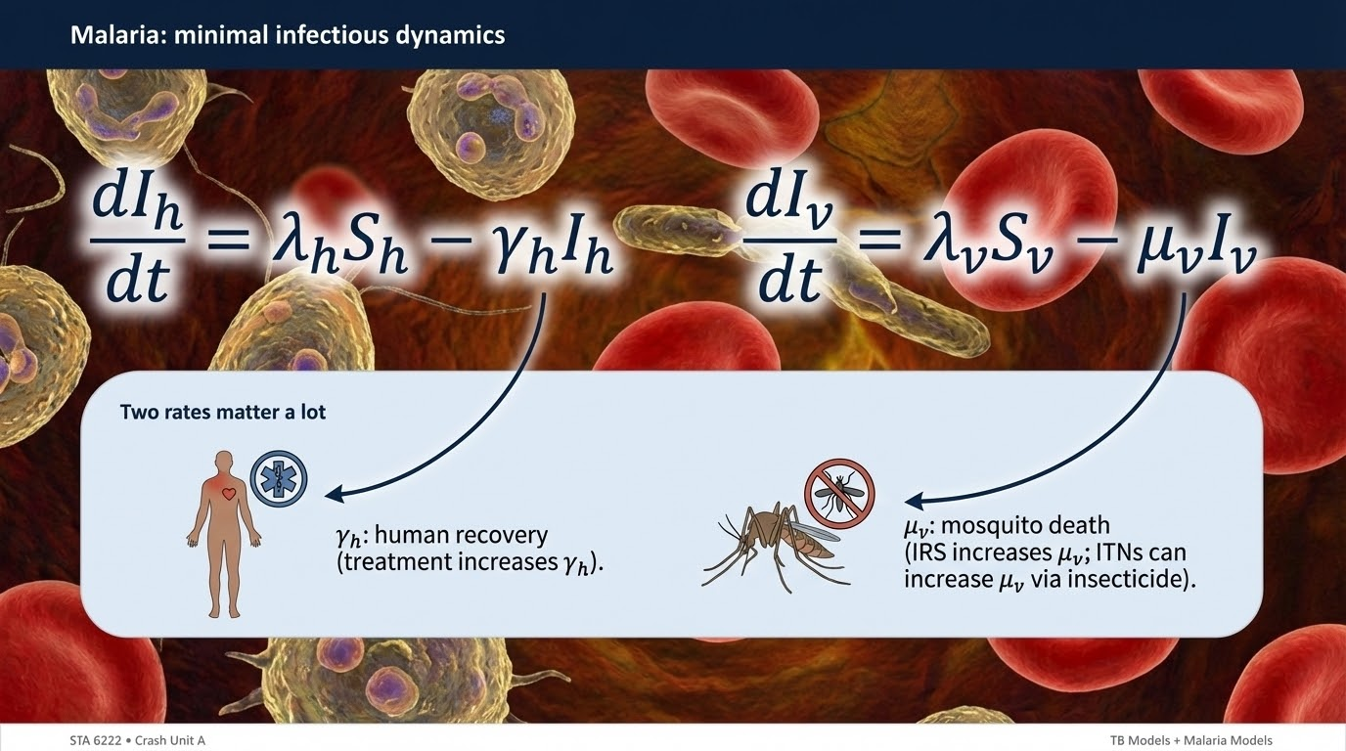
Notes:
Slide 16 — Malaria: minimal infectious dynamics
A minimal infectious dynamics description can be written using these forces of infection. For humans: dI_{h} / dt = 𝝀_{h}S_{h} - 𝜸_{h}I_{h} For vectors: dI_{v} / dt = 𝝀_{v}S_{v} - 𝝁_{v}I_{v}
Here, gamma_h (𝜸_{h}) is the human recovery rate, and mu_v ( 𝝁_{v}) is the mosquito death rate. The structure highlights two powerful control routes. First, reducing the forces of infection lambda_h (𝝀_{h}) and lambda_v (𝝀_{v}) reduces the inflow into the infectious compartments. Second, increasing removal rates decreases infectious prevalence: in humans by increasing gamma_h (𝜸_{h}) through prompt diagnosis and treatment, and in vectors by increasing mu_v ( 𝝁_{v}) through interventions like Insecticide Residual Spraying. A crucial malaria message is that vectors have no “recovery”; mosquitoes leave the infectious state primarily by dying, so mosquito survival is central.

Slide 17
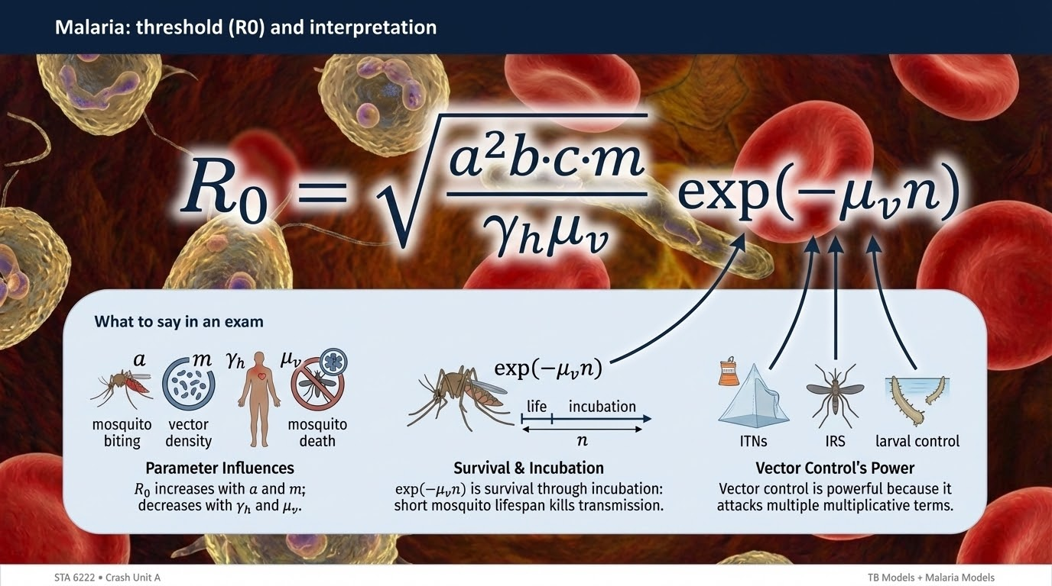
Notes:
Slide 17 — Malaria: threshold (R₀) and interpretation
A commonly cited Ross–Macdonald style expression for R0 includes biting, transmission probabilities, vector density, and mosquito survival. One illustrative form is: R₀ = sqrt( (a²bcm) / (𝜸_{h} 𝝁_{v}) ) * exp(-𝝁_{v}n)
Here, m is a vector-to-human density measure, and n is the incubation period in the mosquito. The interpretation is more important than memorizing the exact expression.
R₀ increases strongly with biting rate a, and it decreases when humans recover faster (higher gamma_h, 𝜸_{h}) and when mosquitoes die faster (higher mu_v,𝝁_{v}). The exponential term shows why mosquito survival is such a major lever: if mosquitoes die quickly, few survive long enough to become infectious. This immediately explains why IRS and ITNs can have very large effects even without perfect coverage.

Slide 18
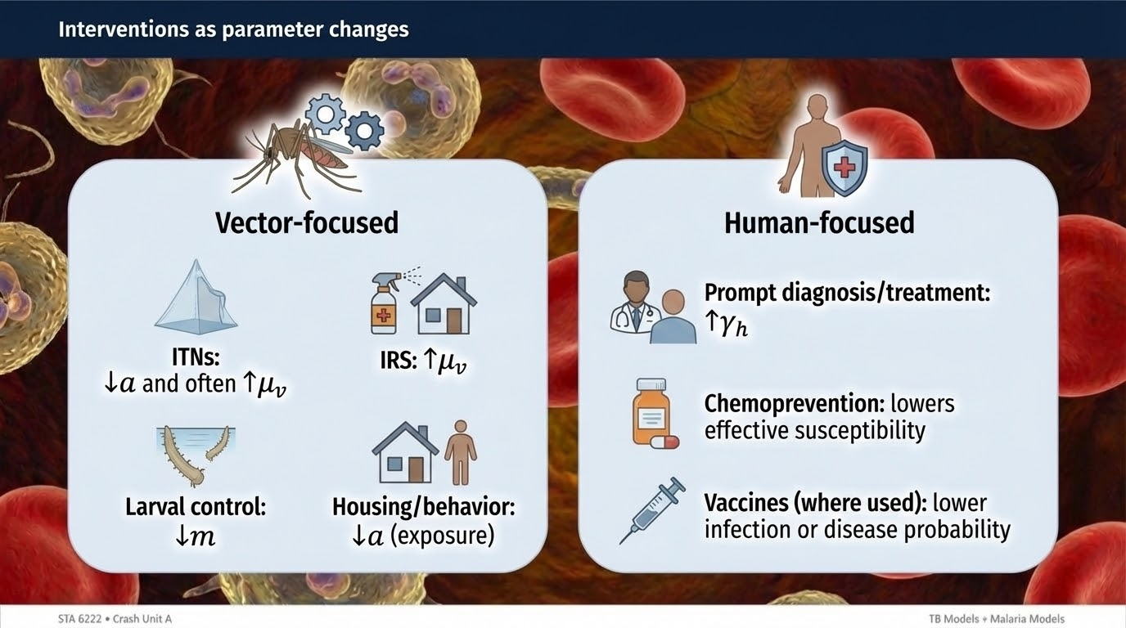
Notes:
Slide 18 — Interventions as parameter changes
Malaria interventions are best understood as parameter changes.
ITNs reduce effective contact between humans and mosquitoes, which is represented as a reduction in a or in the effective transmission probability. Depending on the insecticide, ITNs can also increase mosquito death rate, increasing 𝝁_{v}.
IRS primarily increases mosquito death rate 𝝁_{v}, which reduces mosquito survival and therefore transmission.
Larval control reduces vector density, lowering m.
Housing improvements and behavioural changes can reduce exposure, again lowering effective a.
On the human side, prompt diagnosis and effective treatment increase gamma_h (𝛄_{h}), shortening infectious duration.
The key point is that interventions do not “float above” the model; they enter by changing parameters. When students can state which parameter an intervention changes and in what direction, they have understood malaria control modelling.

Slide 19
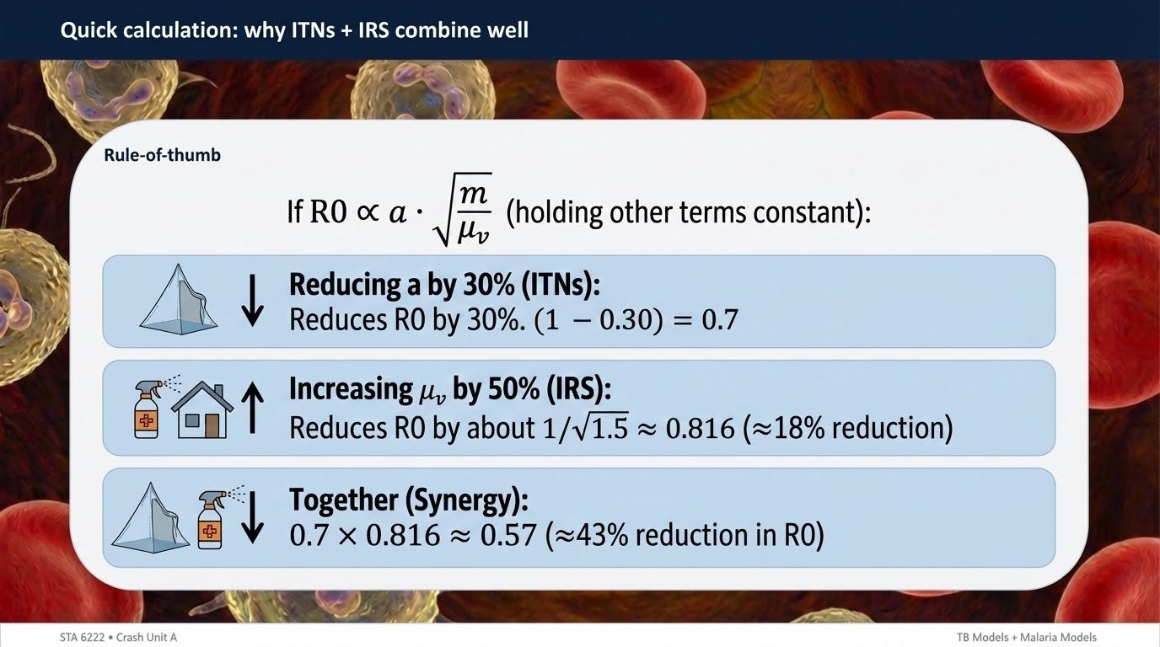
Notes:
Slide 19 — Quick calculation: why ITNs + IRS combine well
Combination interventions often work well because their effects multiply. A useful qualitative approximation is that malaria R₀ increases with biting and decreases with mosquito death rate. If ITNs reduce effective biting rate by, for example, 30%, that means a becomes 0.7*a. If IRS increases mosquito death rate by 50%, that means 𝝁_{v} becomes 1.5*𝝁_{v}, which reduces mosquito survival and infectious vectors. Even without exact formula memorization, the logic is stable: reductions in biting and reductions in mosquito survival compound, so combined interventions can push R₀ below 1 more efficiently than relying on one tool alone. This is why malaria programs rarely choose a single intervention in isolation in high-transmission settings.

Slide 20
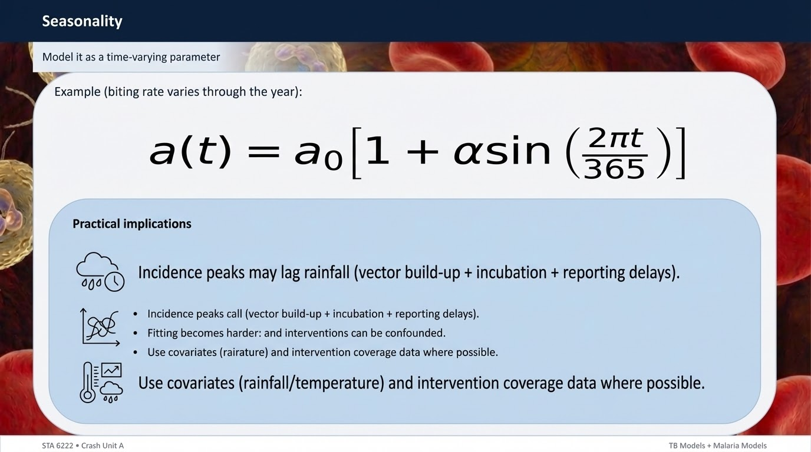
Notes:
Slide 20 — Seasonality
Seasonality can be introduced by making a parameter time-dependent. A common example is the biting rate: a(t) = a₀[1 + 𝜶sin(2𝞹t / 365)]
Here, a₀ is the average biting rate, and 𝜶 is the amplitude of seasonality. If alpha (𝜶) is near zero, biting is roughly constant. If alpha (𝜶) is large, biting varies strongly over the year. Seasonality produces waves in incidence because vector density and biting behaviour change with rainfall and temperature. Importantly, peaks in incidence may lag peaks in rainfall because the mosquito population needs time to grow, and transmission needs time to translate into detected cases. Seasonality also complicates fitting because parameters are no longer constant; a model can fit poorly if it assumes constant transmission when transmission is actually time-varying.

Slide 21
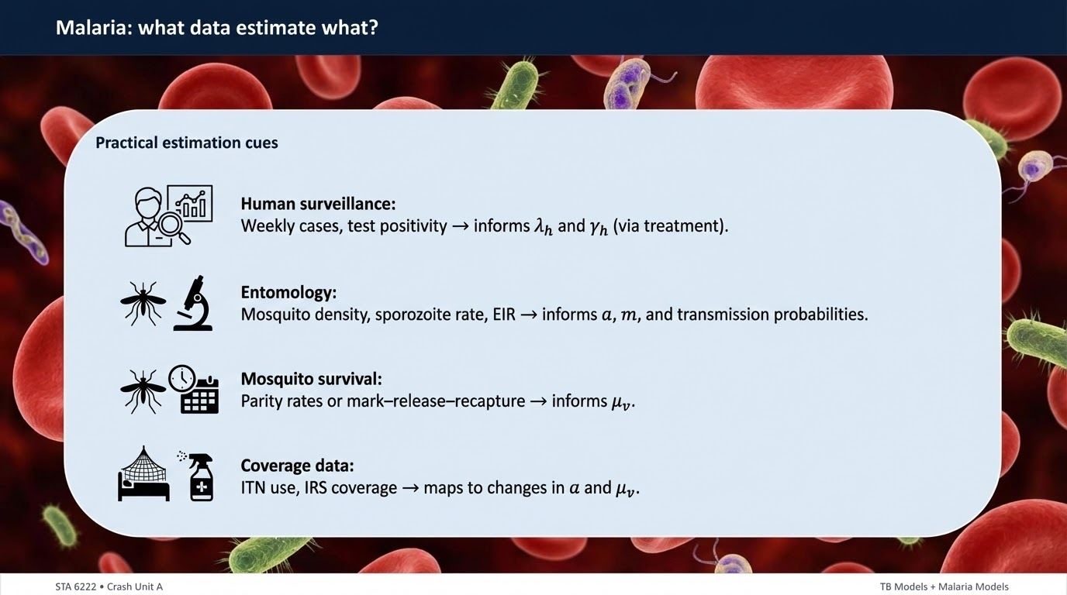
Notes:
Slide 21 — Malaria: what data estimate what?
Malaria parameters are informed by a mixture of clinical data and entomological data.
Human surveillance data—weekly cases, test positivity, admissions—help infer the human-side dynamics and the timing of peaks.
Entomological measures such as mosquito density, biting rates, sporozoite rates, or EIR inform vector-side parameters like a and m and the fraction infectious.
Intervention coverage data—ITN ownership and usage, IRS coverage—inform changes in effective biting and mosquito death.
Treatment coverage and access inform the human recovery rate gamma_h.
A key limitation is identifiability: without vector data, multiple combinations of a, m, and mu_v can produce similar human incidence curves, so model fitting can be underdetermined. This is why malaria modelling benefits greatly from combining routine surveillance with targeted entomological measurements.

Slide 22
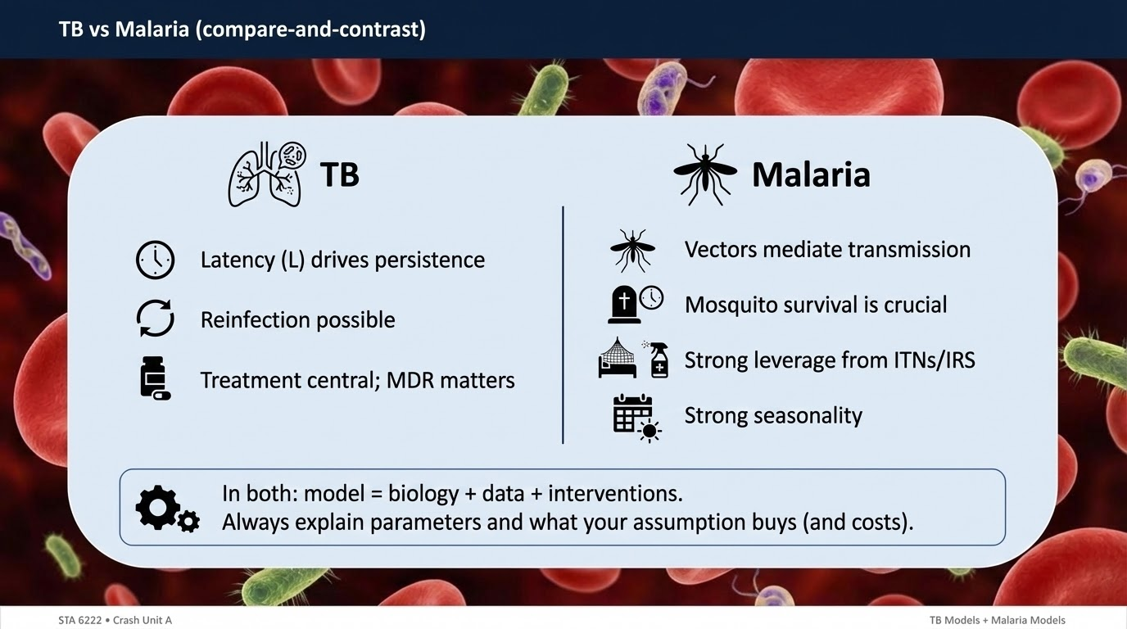
Notes:
Slide 22 — TB vs Malaria (compare-and-contrast)
TB and malaria are useful contrasts. TB persistence is driven largely by the latent reservoir. The key modelling problem is progression from latent to infectious and how treatment changes infectious duration and resistance risk. Malaria persistence is driven by the host–vector loop and mosquito survival. The key modelling problem is how biting, vector density, and mosquito death rate determine transmission potential, and how interventions change those parameters. TB typically has slower time scales and less dramatic seasonality, whereas malaria often has strong seasonal waves. Both systems teach the same modelling discipline: write biology as compartments and flows, interpret parameters epidemiologically, use thresholds like R0 to understand persistence, and translate interventions into parameter changes that can be measured and improved.

Slide 23
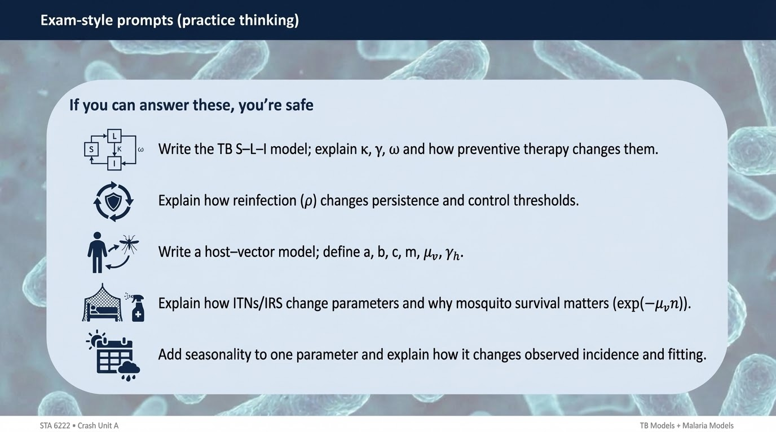
Notes:
Slide 23 — Exam-style prompts (practice thinking)
The exam-style prompts are simply testing whether the modelling logic is internalized. For TB, a typical prompt expects a clean S–L–I structure, correct definitions of beta, kappa, gamma, and an explanation of why latency causes delayed incidence and persistence. Extensions test whether reinfection and treatment are understood as changes to flows or rates, and whether MDR can be represented as a split into drug-sensitive and drug-resistant infectious classes. For malaria, exam prompts commonly test the host–vector loop, the correct forces of infection, and the interpretation of parameters like biting rate and mosquito death. Seasonality questions test whether you can represent time-varying transmission and explain how it changes patterns and fitting. Clear explanations often score as heavily as the equations.

Slide 24
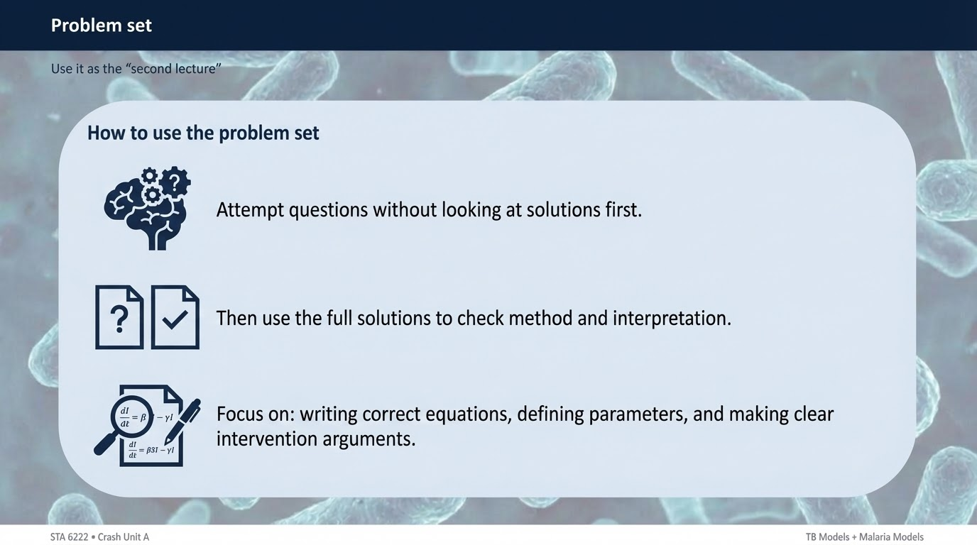
Notes:
Slide 24 — Problem set
The problem set is designed to turn this crash unit into something examinable. The expected approach is: first, attempt each question using the model structures discussed—TB S–L–I and malaria host–vector. Second, check your parameter meanings; many marks are lost by writing correct algebra with incorrect interpretations. Third, use the solutions to learn the “model-building style”: how to start with a force of infection, how to place terms in the correct compartment equation, and how to argue intervention effects through parameter changes. A strong answer is not just a final equation; it is a coherent model statement: compartments, flows, parameters, and interpretation. That is exactly how the exam marking logic is structured.

Slide 25
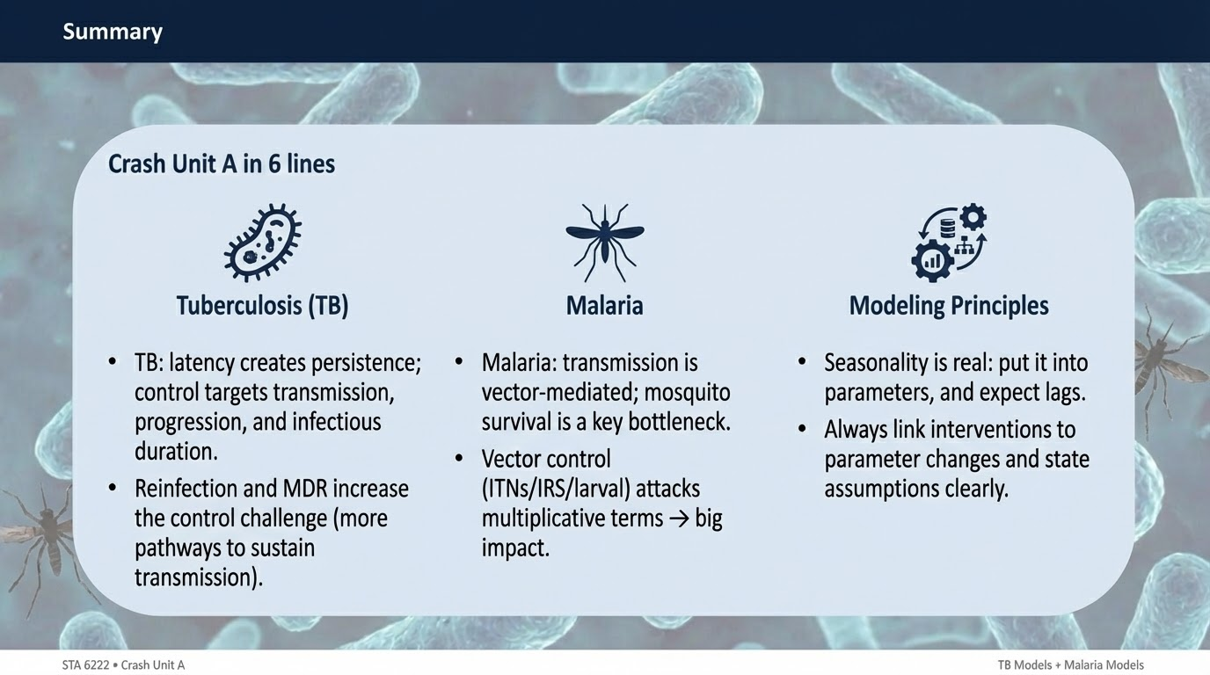
Notes:
Slide 25 — Summary
This crash unit can be summarized in a few ideas. For TB, latency is the defining feature: infection accumulates in L, and progression from L to I determines future incidence. Reinfection and partial immunity can sustain the system, treatment reduces infectious duration and transmission, and MDR can be represented as a two-strain extension with important program implications. For malaria, vectors are not optional: transmission is a loop between humans and mosquitoes. Forces of infection depend on biting rate and the infectious fraction on each side. R0 depends strongly on biting and mosquito survival, which is why ITNs and IRS are powerful tools. Seasonality can be represented with time-varying parameters and explains recurrent waves. If these interpretations are clear, the mathematical forms become much easier to remember and use.

Slide 26
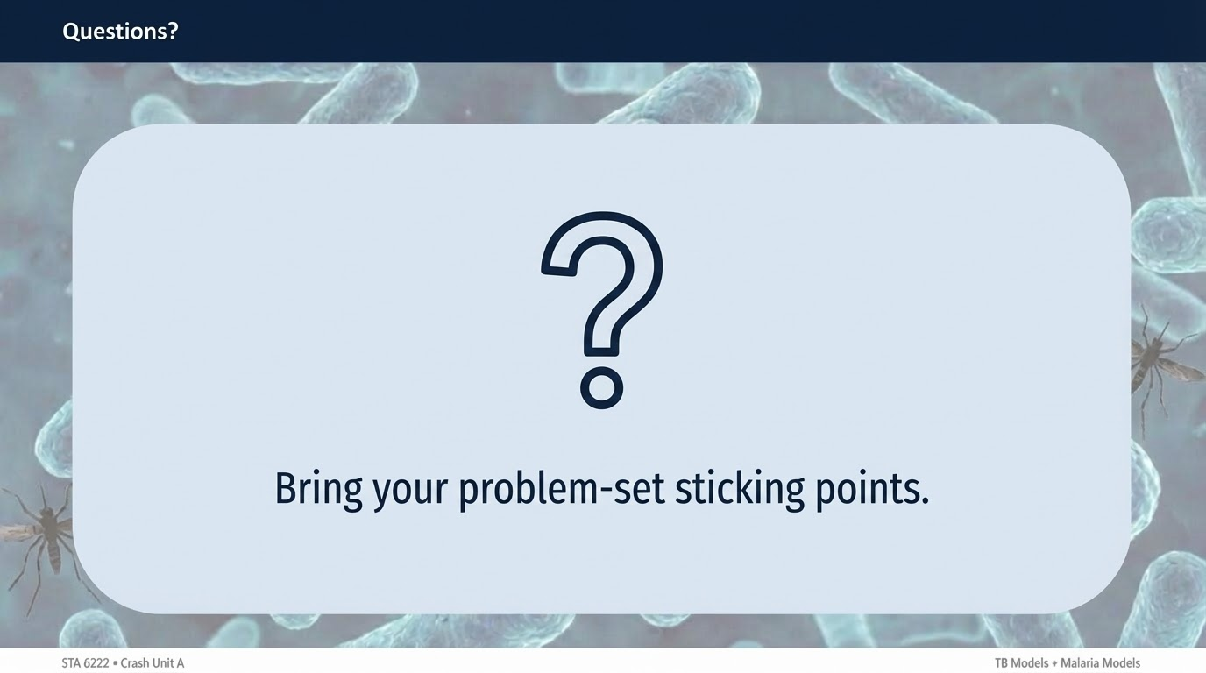
Notes:
Slide 26 — Questions?
At this stage, the most productive questions are the ones tied to specific model steps. A useful question sounds like: “In the TB model, where exactly does reinfection enter and what does rho mean?” or “In the malaria force of infection, why does lambda_h depend on I_v/N_v rather than I_h/N_h?” or “When I introduce seasonality into a(t), what do I expect to happen to the timing of peaks?” Those questions confirm that the model structure and parameter meanings are solid. When the structure and interpretation are correct, the algebra usually falls into place naturally.

